Slide 1
Front End Engineering-I Project
Team Details:
Diyanshi Gupta(2210990305),
Drishti Bhardwaj(2210990306),
Drishya Sood(2210990307),
Eshaan Garg(2210990308)
Faculty Coordinator: Dr Monika Sethi
:
Chitkara University Institute of Engineering and Technology,
Chitkara University, Punjab

Slide 2
Table of Contents
Introduction
Problem Statement
Technical Details
Key Features
Project Highlights
Conclusion
References/Links used

Slide 3
Introduction
TRIBUTE PAGE
The Tribute Page project is an initiative designed to honour outstanding people who have made noteworthy achievements in their respective disciplines. This online memorial website honours and celebrates the contributions and influence of these extraordinary people by sharing their life stories and achievements with visitors in an effort to motivate and inform them.
The project's goal is to create a user-friendly website that offers a thorough and interesting tribute experience. The homage page showcase s a wide range of exceptional people from various origins, fields, and eras. Each person is picked with attention based on their remarkable accomplishments, social influence, and capacity to motivate younger generations.
The tribute website is divided into different sections to give users an engaging experience. Users are encouraged to learn more about the highlighted people and their efforts by reading the brief introduction on the main page. The menu's seamless navigation across the various parts includes a "About" page that gives a summary of the project's goals and objectives.

Slide 4
Problem Statement
A tribute page is a special page created to honour your loved one's life and memories. It is a permanent monument where you, your loved ones' family, and friends may share countless memories and pictures to honour their life.
Our project honours a few outstanding individuals who have made significant contributions to their areas in a little way.
The objective of the tribute page project is to create a compelling and informative web page dedicated to honoring and celebrating the life and achievements of a notable individual. The page aims to provide a comprehensive overview of the person's contributions, inspiring qualities, and lasting impact on society.
Through this project, our goal is to create a visually appealing and user-friendly tribute page that engages visitors and encourages them to learn about the remarkable accomplishments of the subject. The page will incorporate well-researched information, captivating visuals, and interactive elements to enhance the user experience and evoke a sense of admiration and respect.

Slide 5
Technical Details
We used HTML and CSS to design a home page and tribute page. We used javascript as well. We used Visual Code Studio to write these codes.

Slide 6
Key Features
Following are the html Tags:
<!DOCTYPE html>: This declaration specifies the version of HTML being used (HTML5) to the browser.
<html>: The root element of the HTML document.
<head>: Contains meta-information about the HTML document.
<title>: Sets the title of the HTML document, which appears in the browser's title bar or tab.
<link>: Specifies an external CSS stylesheet to be applied to the HTML document.
<body>: Contains the visible content of the HTML document.
<header>: Represents the header section of the webpage, typically containing a heading or logo.
<h1>: Defines the main heading of the page.
<nav>: Indicates the navigation section of the webpage.
<ul>: Defines an unordered list.
<li>: Represents a list item within an unordered or ordered list.
<a>: Creates a hyperlink to another web page or a specific location within the same page

Slide 7
Following are the CSS Tags:
background-color: Sets the background color of the entire webpage.
font-family: Specifies the font family to be used for the text.
color: Sets the text color within the header.
padding: Adds space around the content inside the header.
text-align: Centers the text within the header.
margin: Sets the margin around the heading.
list-style-type: Removes the bullet points from the unordered list.
overflow: Specifies the behavior when the content of the unordered list exceeds its container.
float: Positions the list items side by side.
display: Sets the element as a block-level element.
text-decoration: Removes the underline from the navigation links.
margin-top: Sets the margin on the top of each section.

Slide 8
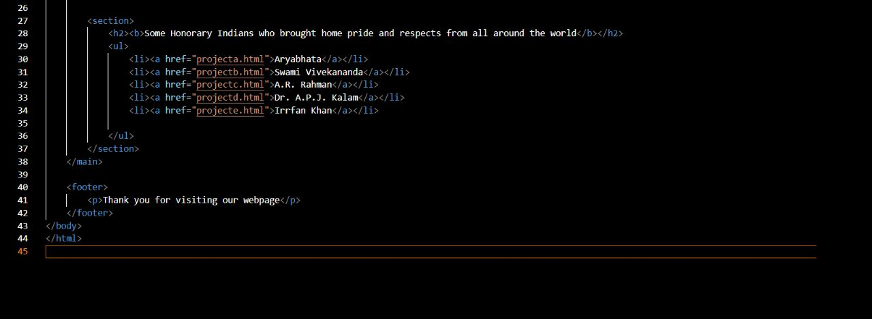
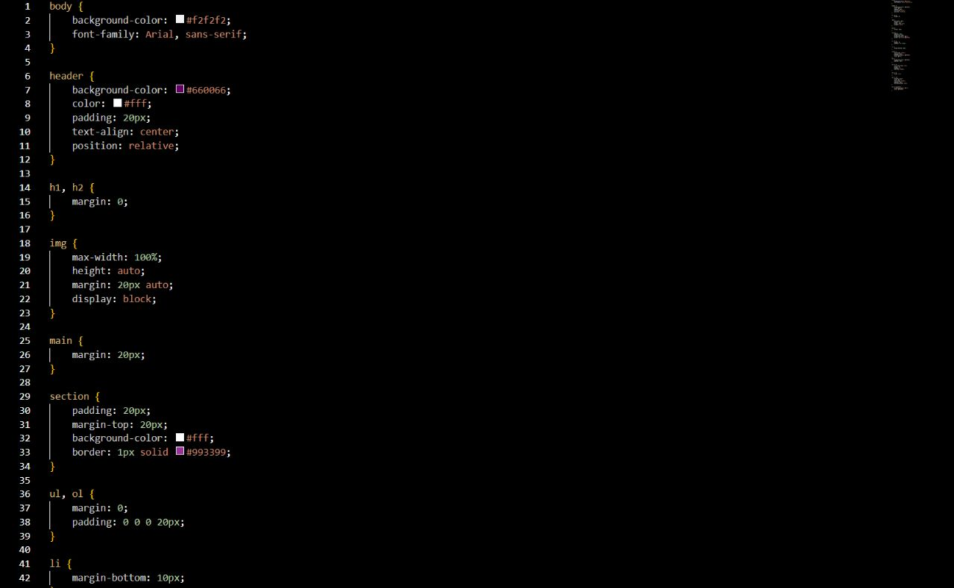
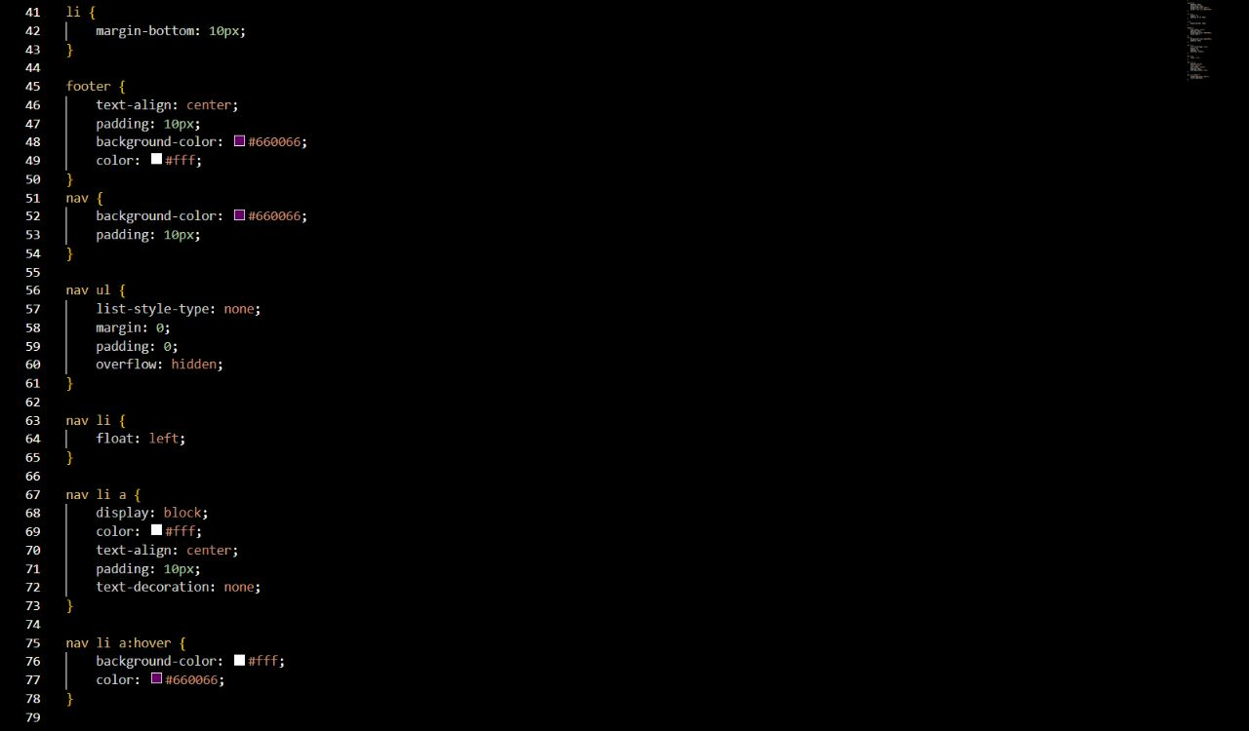
Project Highlights 1
HTML CODE SNIPPETS:

Slide 9
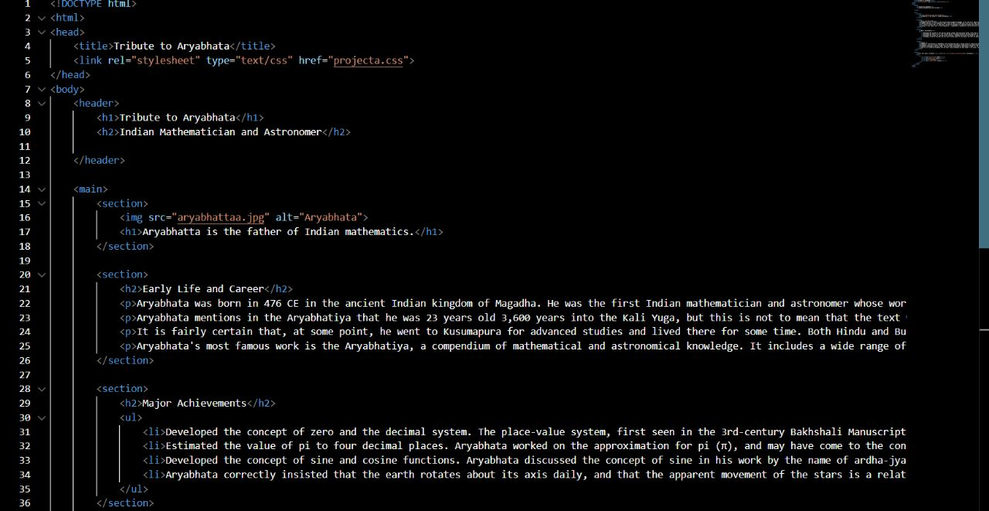
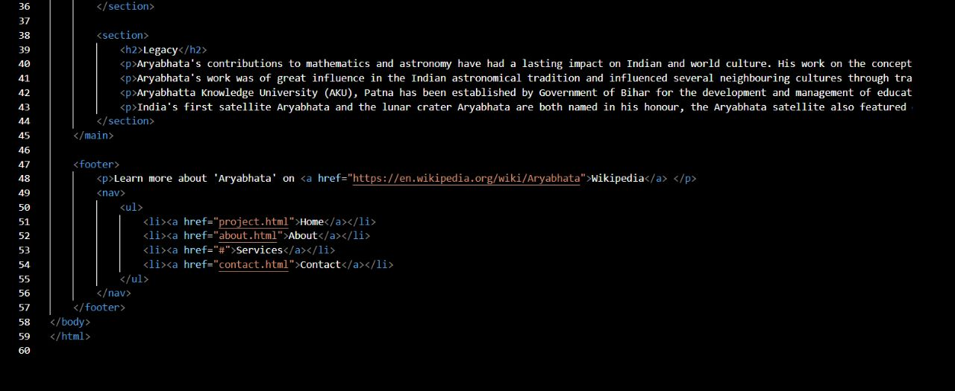
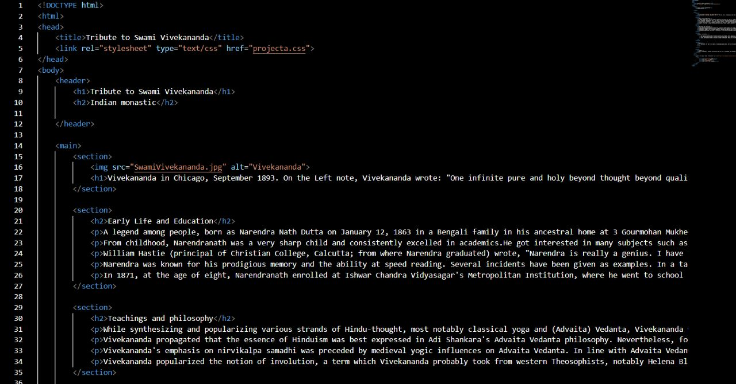
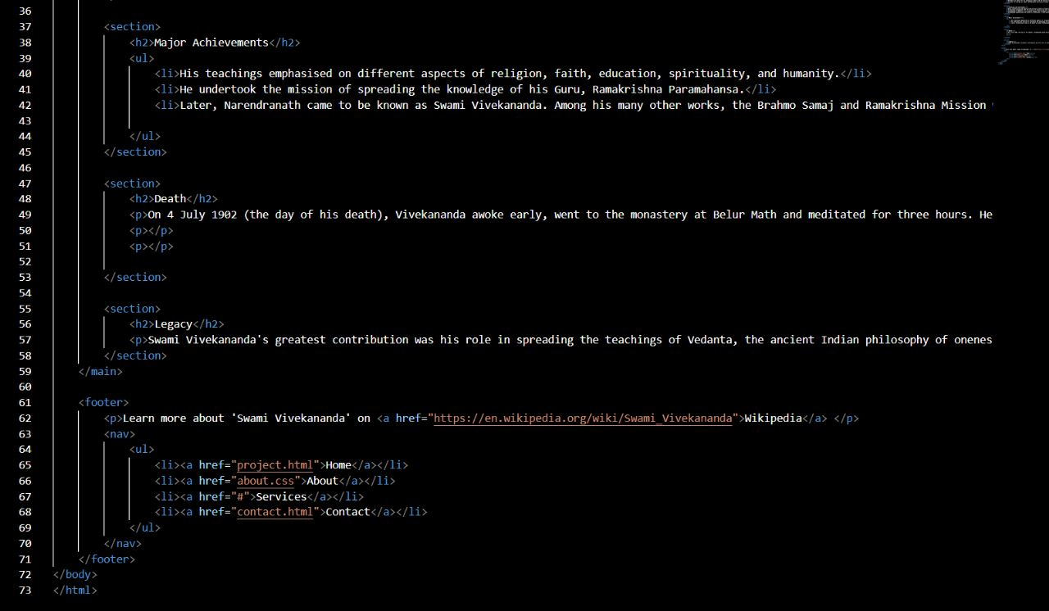
Project Highlights 2
CSS CODE SNIPPETS:

Slide 10
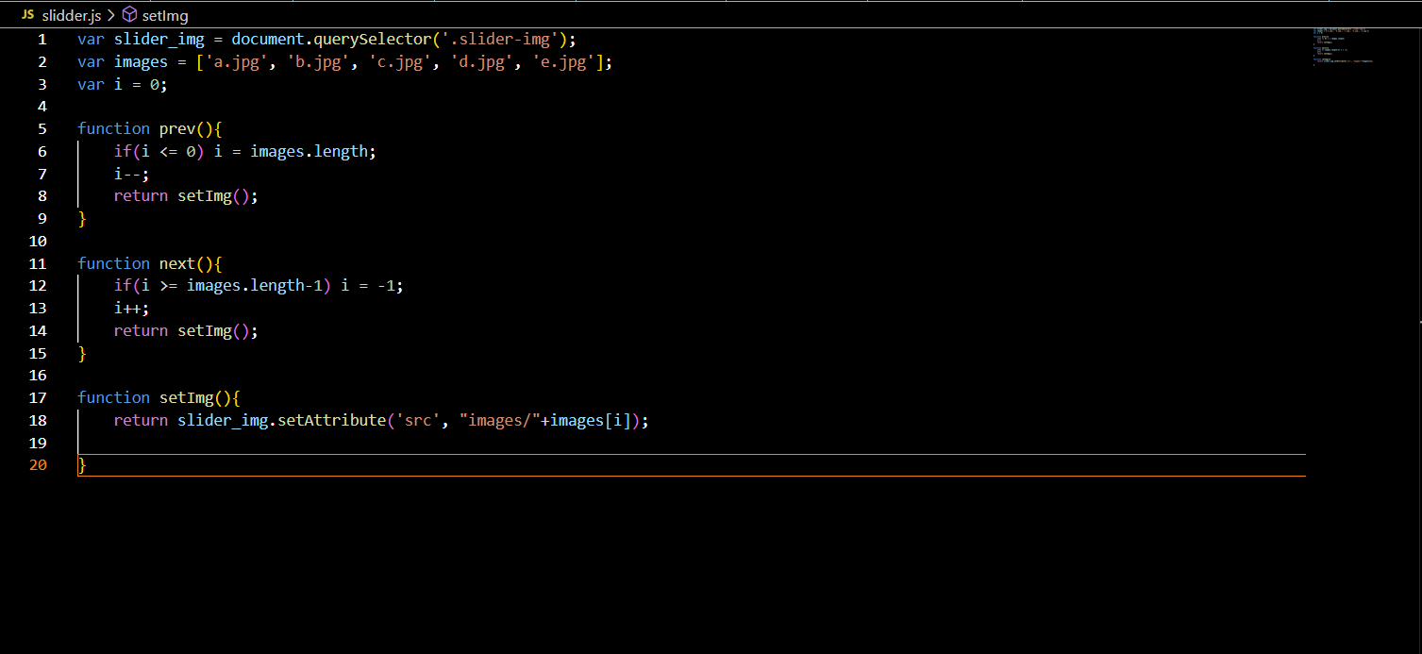
Project Highlight 3

Slide 11
Conclusion
A tribute page project's possible future scope offers a number of extension and improvement options:
Interactive Elements: Including interactive features like polls, quizzes, or multimedia material can boost user engagement and create a more engaging environment. Visitors who actively engage in the tribute page can strengthen their understanding and relationship with the person being honoured thanks to these elements.
Collaboration and social sharing: By incorporating social media sharing buttons and allowing user-generated content, the memorial page can be shared with a larger audience. Allowing people to add their own reflections, recollections, or anecdotes about the individual can also promote a sense of community and promote teamwork.
Integration of multimedia: You can improve the user experience by adding more audio or video clips, interviews, or virtual tours to the tribute page. A more thorough picture of the person's accomplishments can be provided through this multimedia integration, which also offers an exciting and dynamic platform for inquiry.
The memorial page project can be expanded to include many profiles in addition to the initial focus on a single well-known person. This expansion might include a number of memorial sites for different people in various professions, highlighting their distinctive contributions and encouraging a wider understanding of a variety of skills and accomplishments.

Slide 12
References/Links used
WIKIPEDIA- https://www.wikipedia.org/
W3SCHOOLS-https://www.w3schools.com/

Slide 13


